Slide 1

Wayfarer
Ryan Stelzer
Dr. David Gaylor
April 16th, 2016
Arizona Space Grant Symposium

Slide 2
Agenda
Objective
System Requirements
Subsystem Components
Next Steps

Slide 3
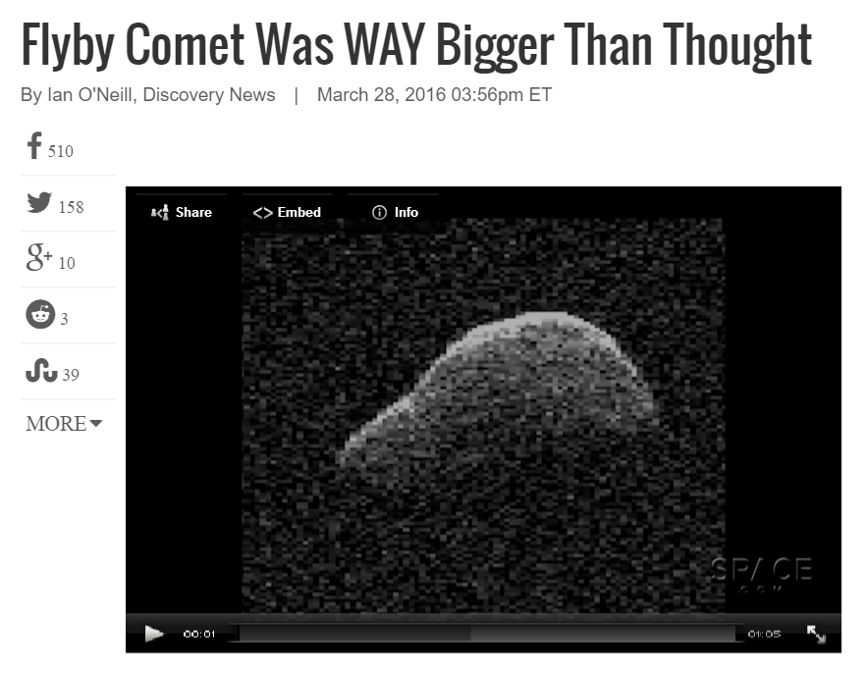
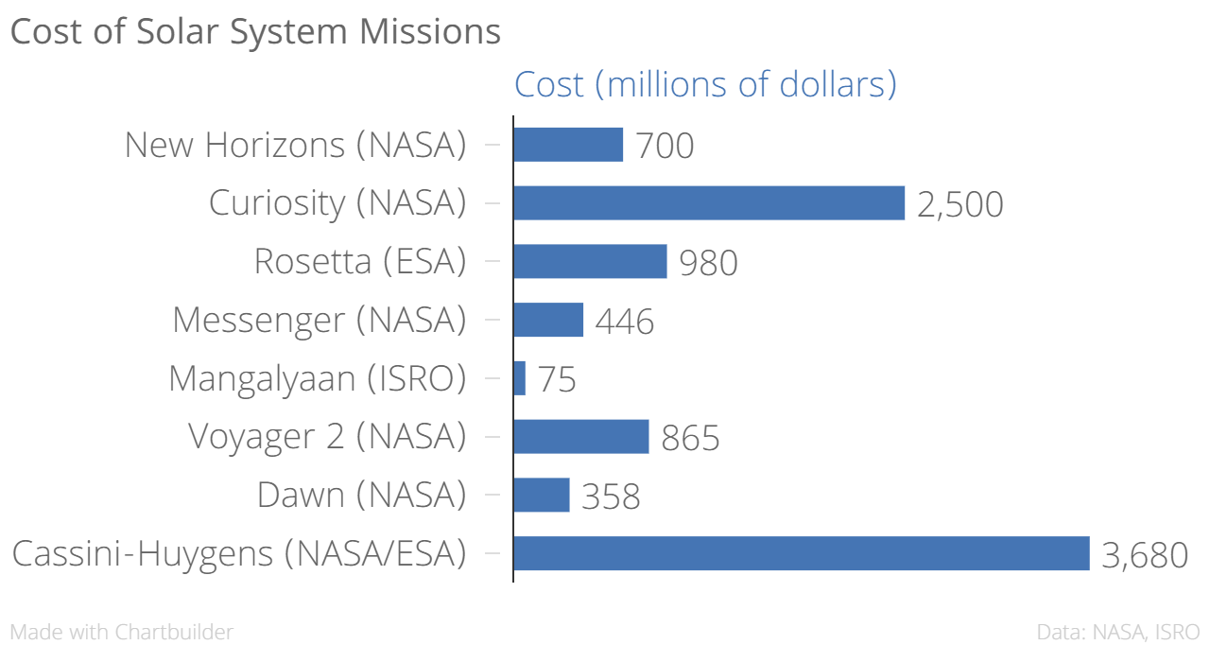
Problem
Current methods for exploring space extremely costly and slow to respond
No on demand survey missions: target selected well before launch
Inner solar system celestial objects under categorized
Space.com, March 28th
Forbes.com

Slide 4
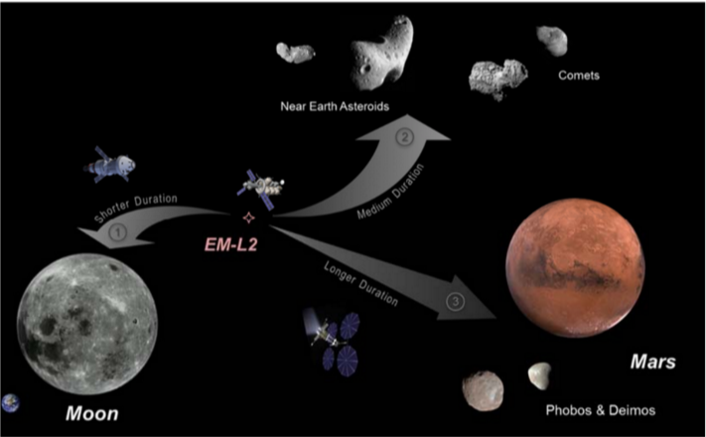
Objective
To develop framework for general purpose, rapid response Nanosatellite
Eventually have fleet in parking orbit waiting for a task
Proof of concept for CubeSat rendezvous with comet Schwassmann–Wachmann 3
Technology Demonstration
Science

Slide 5
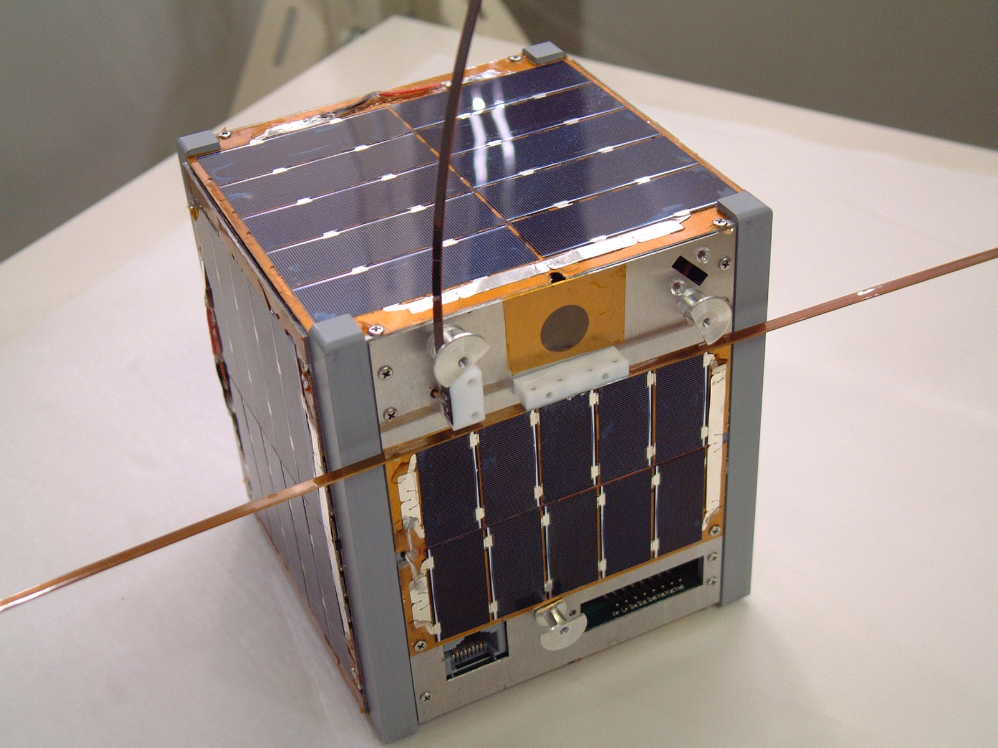
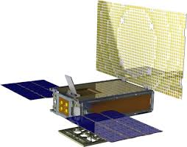
What is a CubeSat?
Miniature satellite
1U of volume = 10 x 10 x 10 cm³
6U = 30 x 20 x 10 cm³
Rideshare options
Low cost
Relatively new technology
University of Tokyo Cubesat
MarCO

Slide 6
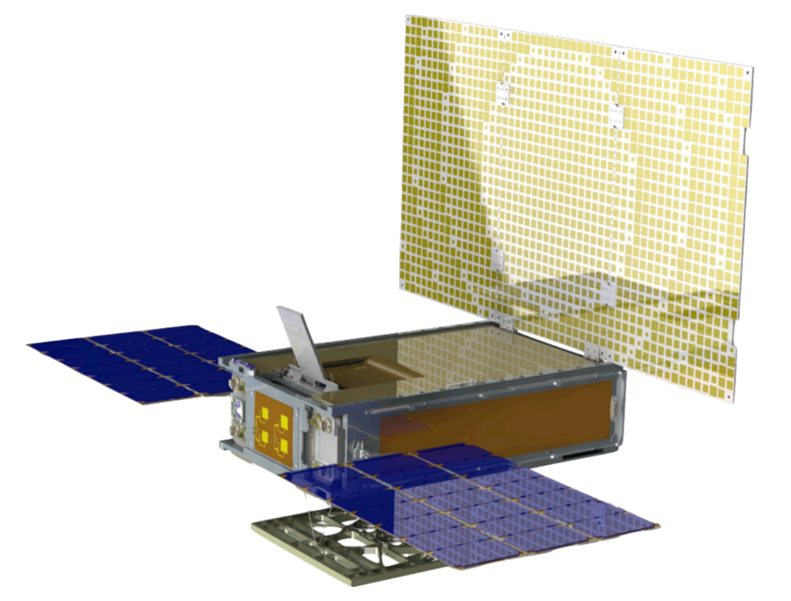
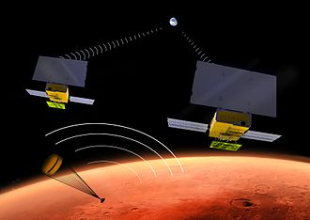
MarCO (Mars Cube One)
Two 6U CubeSats will accompany InSight to Mars
Relay data during Entry, Descent, and Landing
First deep space CubeSat (scheduled for 2018)

Slide 7
Design Approach
Subsystems/Trade Studies:
Power
Propulsion
Communications
Attitude Determination
Orbital Requirements
Torquing
Thermal
Constraints:
Volume: 6U
Mass: 14 kg
Power: 55 Watts
Cost: Approx. $5-6 million
Notes:
Budgets for cost, mass, volume and power
Volume: 6U, Mass: 14 kg, Power: 55 Watts, Cost: Approx. 5-6 million US Dollars,
Subsystems/Trade Studies: Power, Propulsion, Communications, Attitude Determination, Orbital Requirements, Torquing, Thermal

Slide 8
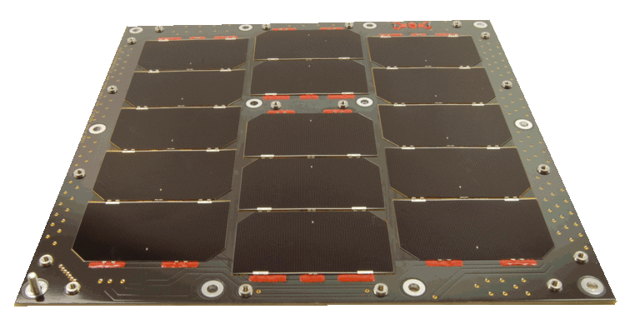
Power
Power Required: 55 (Watts)
Distance from Sun: max 1.3 AU
Manufacturer: Clyde Space
Panels: ~200 W/m²
Area Needed: 0.284 m²
Notes:
Actual panel will fold up, the one above is a non folding panel.
Talk about, how part was chose, why it was chose

Slide 9
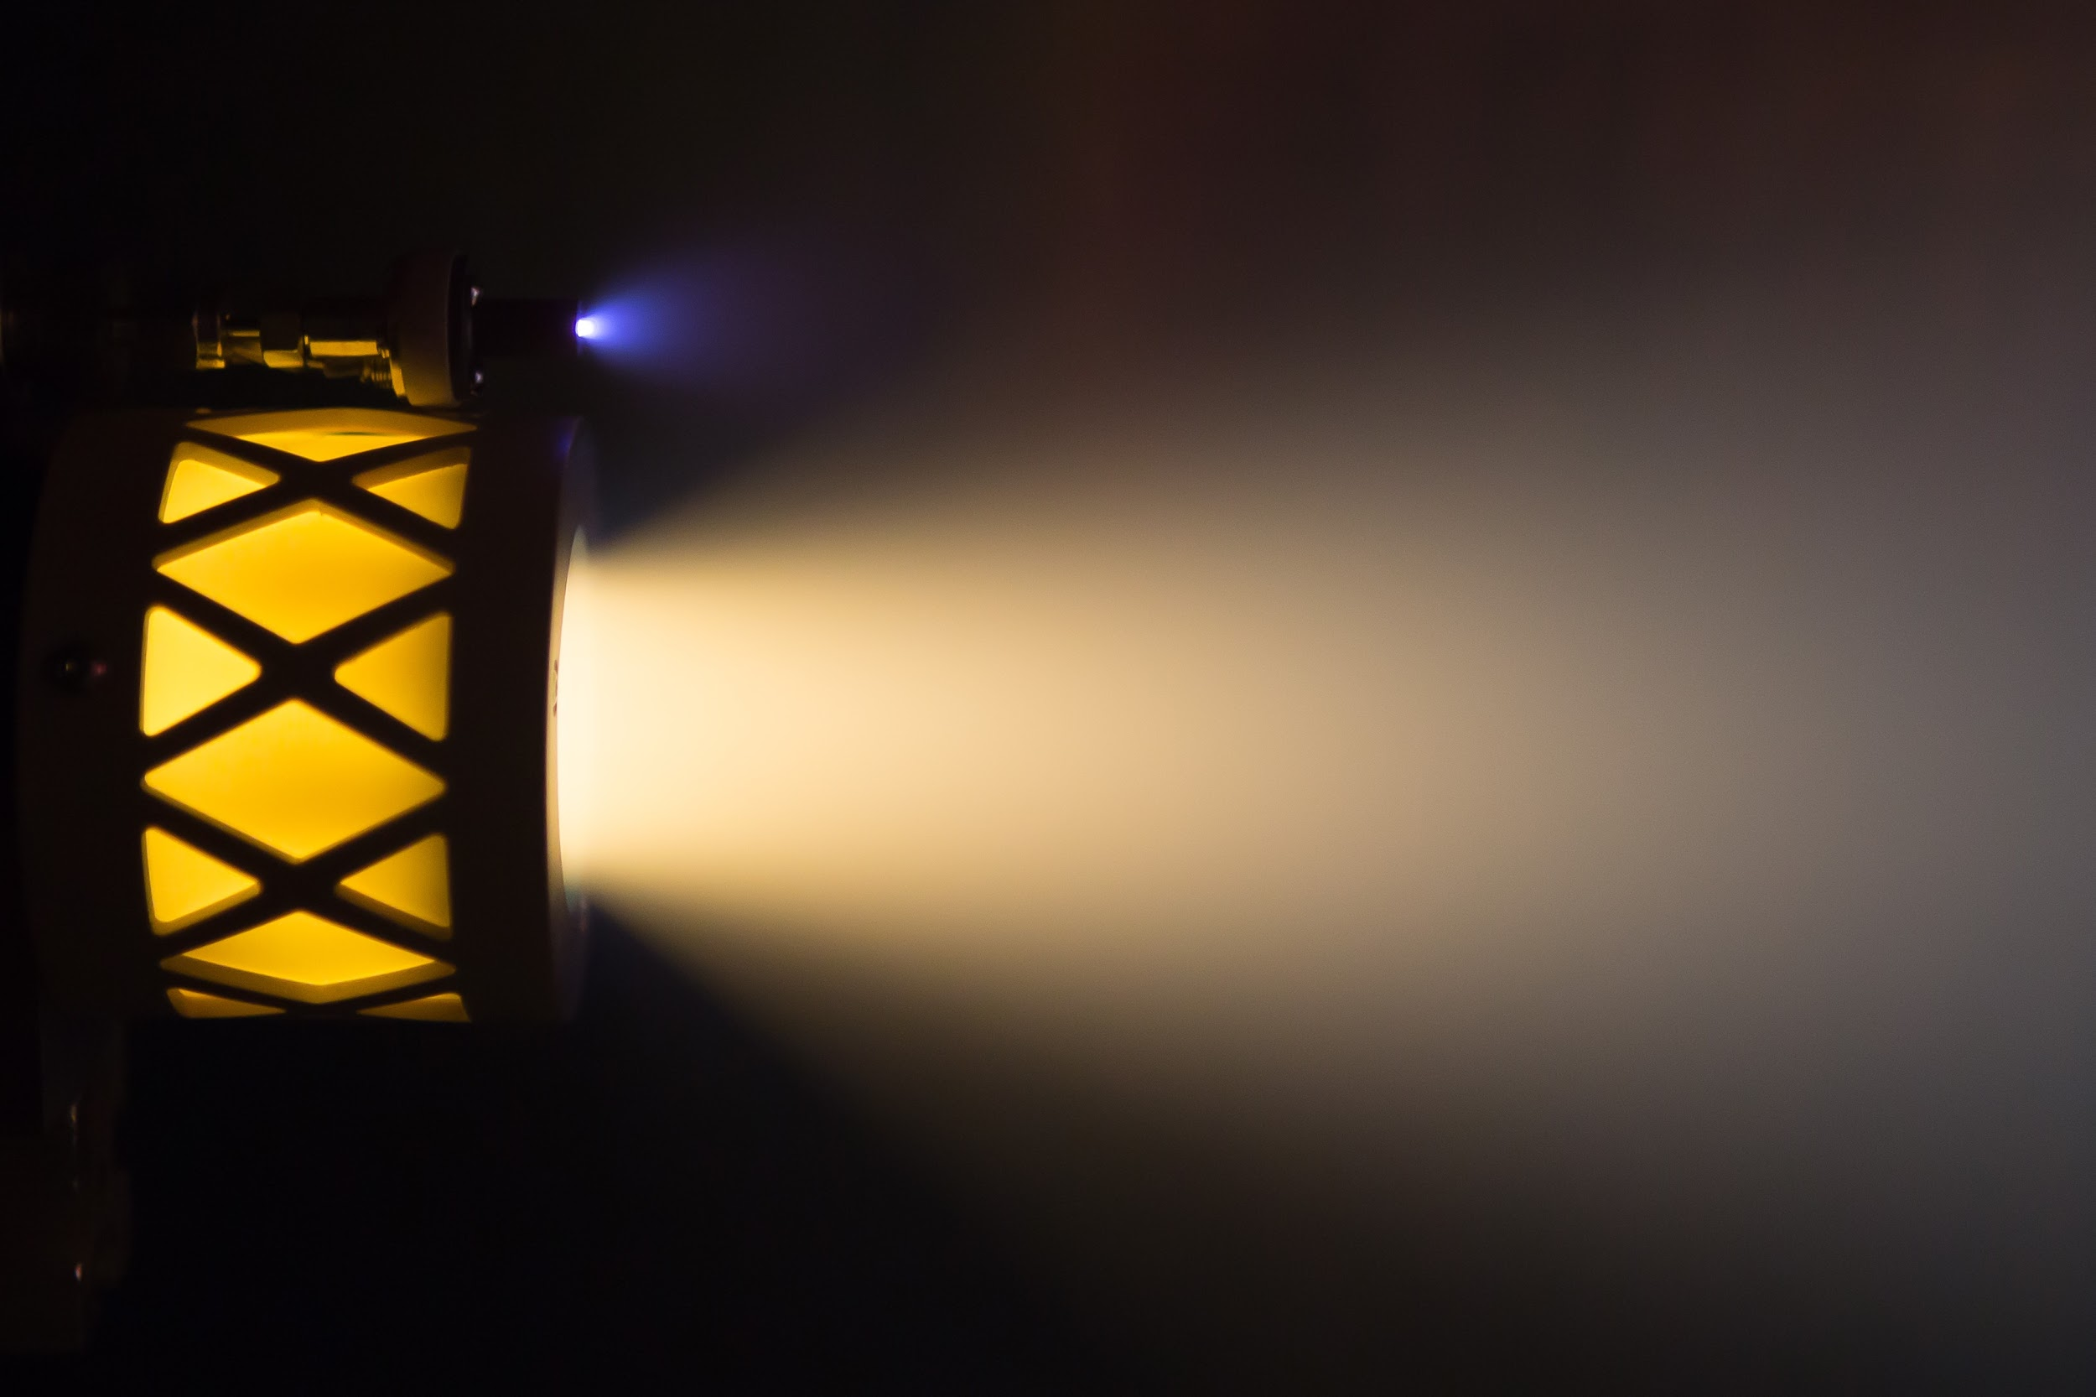
Propulsion
Busek BIT-3 Engine
Ion Propulsion
50 Watts needed
High efficiency, ~3500 sec ISP
20,000 hour lifetime
Iodine propellant
2.5 kg of fuel needed
Notes:
Details about specifications, why these are auditable for mission, why they are the best choice
Iodine propellant, does not have to be as pressurized and is higher density than Xenon - so takes up less space, and lighter storage apparatus can be used
http://www.clyde-space.com/cubesat_shop/solar_panels/6u_solar_panels/335_6u-cubesat-side-solar-panel

Slide 10
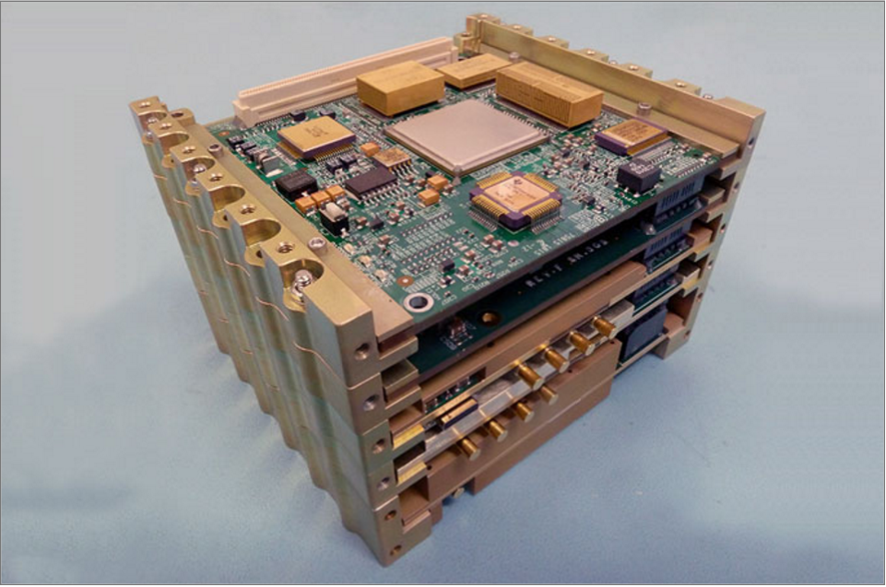
Communications
Iris Transponder
Developed by JPL
0.5 U, 1.2 kg
26 W at full transpond
On MarCO Cubesats

Slide 11
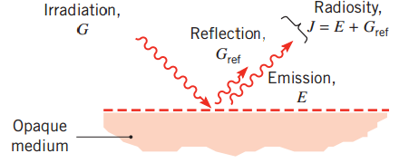
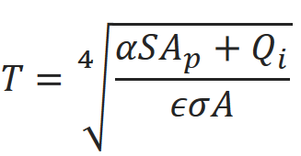
Thermal
1.5 AU with engine off → 1 AU with engine on
Solar Panels: -5 to 55 C
Body of CubeSat: -57 to 10 C
Battery will have heating system
Next Steps:
Use FEA software
Energy output particular parts

Slide 12


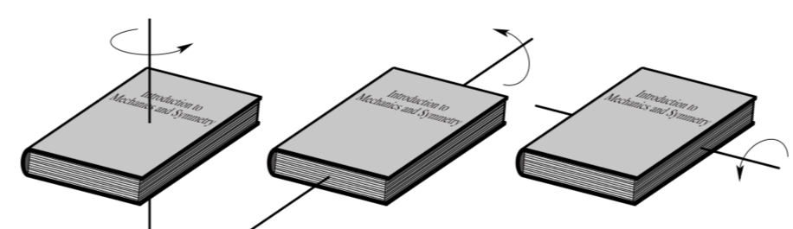
Torquing
Results:
How we go from mass and dimensions to inertia:

Slide 13
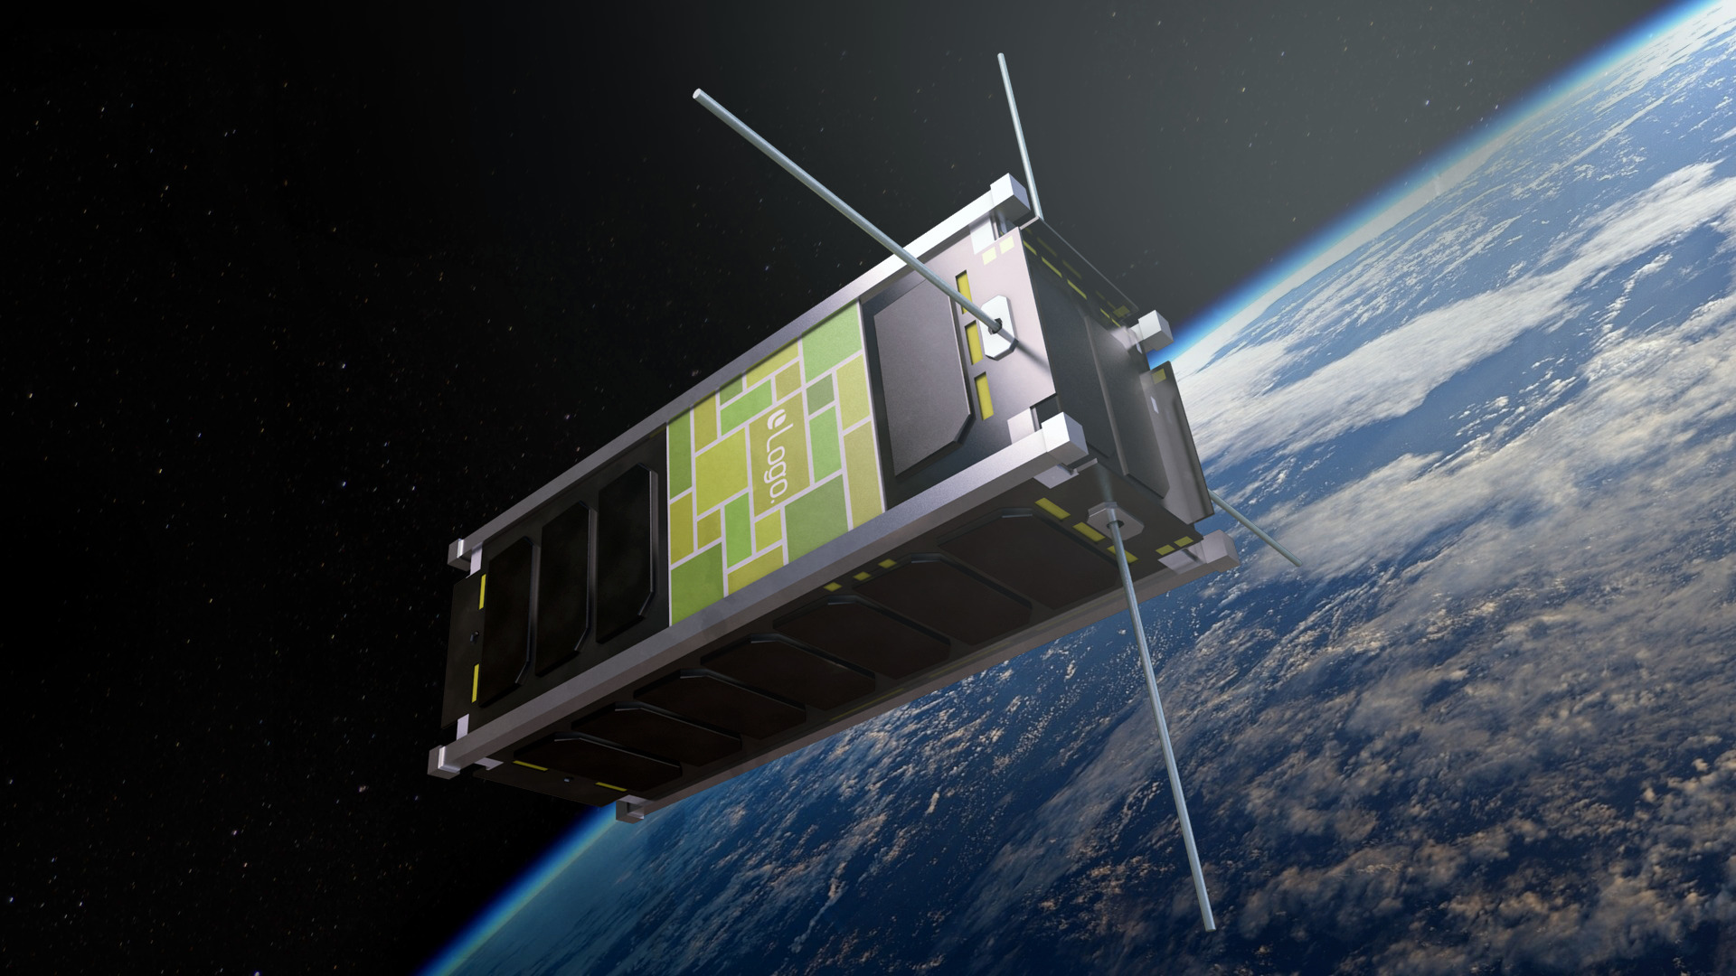
Next Steps
Finalize trade study results
Write detailed proposal based on our research

Slide 14

Thank You!
Dr. David Gaylor
NASA Space Grant & Arizona Space Grant Consortium

